Slide 1
Section 8.4 Function Notation
Definition
The dependent variable of a function f can be represented by the expression formed by writing the independent variable name within the parentheses of f ( ):
dependent variable = f (independent variable)
We call this representation function notation.

Slide 2
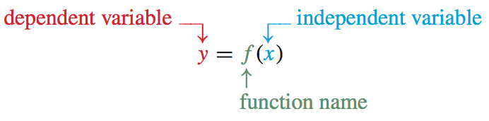
Function Notation – Example
To use “f ” as the name of the linear function y = 2x + 1 , we use “f (x)” (read “f of x”) to represent y:
We refer to “f (x)” as function notation. To use function notation to write the equation of this function, we substitute f (x) for y in the equation y = 2x + 1: f (x) = 2x + 1

Slide 3
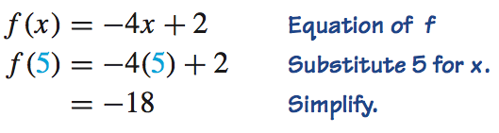
Evaluating a Function
Example 1
Evaluate f (x) = −4x + 2 at 5.
Solution
This means to use x = 5 and substitute into the function.
Notice that the LEFT side of the equals sign is only a “label.” It is telling you that you are plugging 5 into the function f.
It does NOT mean 5 times f, as if you were solving for f.
The RIGHT side of the equals sign is where the computation takes place.
The 5 is the input, or x–coordinate, and the –18 is the output, or the y–coordinate.
That means the ordered pair, or the point (5, –18) lies on the graph of this f (x) .

Slide 4
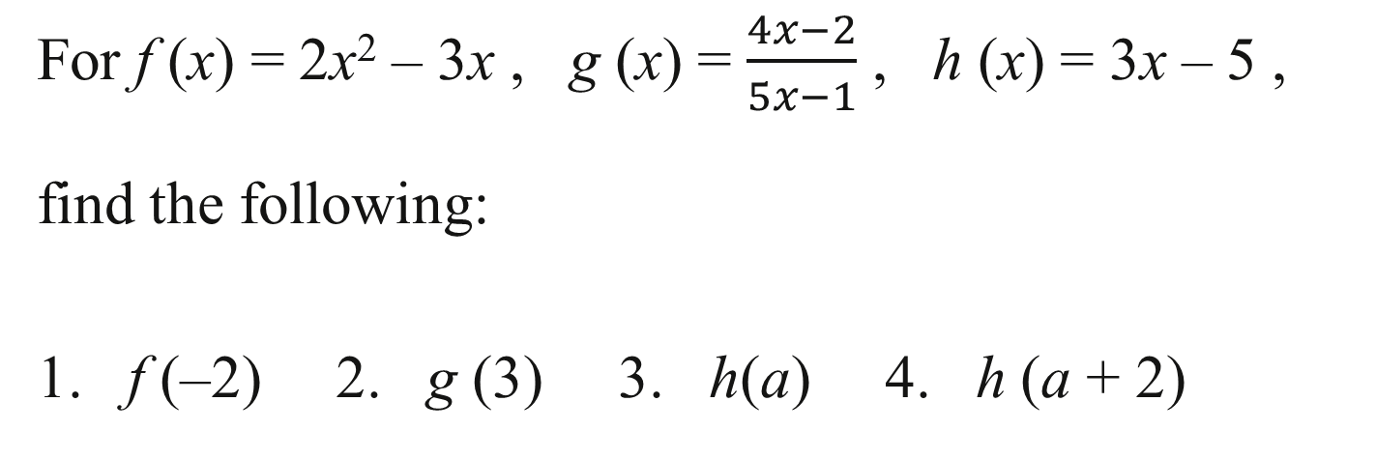
Evaluating a Function
Example 2
For f (x) = 2x² – 3x , g (x) = $\frac{4x−2}{5x−1}$ , h (x) = 3x – 5 ,
find the following:
1. f (–2) 2. g (3) 3. h(a) 4. h (a + 2)

Slide 5
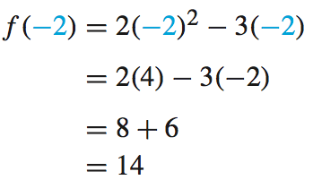
Evaluating a Function
Solution
1. f (–2)
We plug in x = –2 into f (x) = 2x² – 3x , and then simplify:

Slide 6
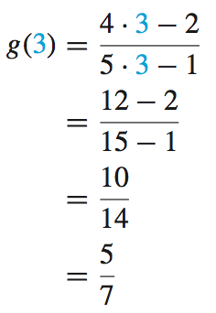
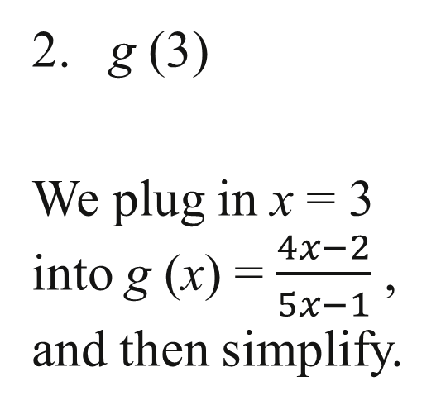
Evaluating a Function
Solution continued
2. g (3)
We plug in x = 3 into g (x) = $\frac{4x−2}{5x−1}$ , and then simplify.

Slide 7

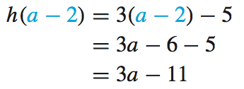
Evaluating a Function
Solution continued
3. h(a)
We plug in x = a into h (x) = 3x – 5 and simplify:
4. h (a + 2)
We plug in x = a – 2 into h (x) = 3x – 5 and simplify:

Slide 8
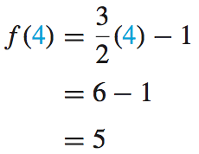
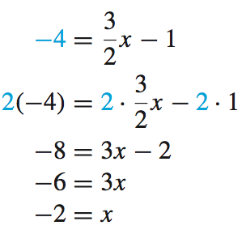
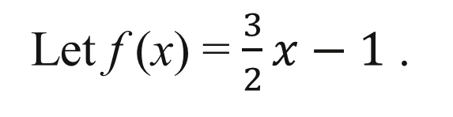
Using an Equation to Find an Output and an Input
Example 4
Let f (x) = $\frac{3}{2}x−1$ .
1. Find f (4) . 2. Find x when f (x) = –4.

Slide 9
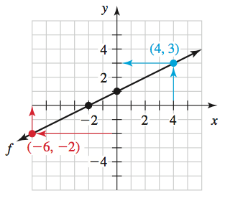
Using a Graph to Find Values of x or f(x)
Example 5
A graph of a function f is sketched.
1. Find f (4).
2. Find f (0).
3. Find x when f (x) = −2.
4. Find x when f (x) = 0.

Slide 10
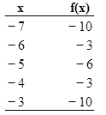
Using a Table to Find Values of x or f (x)
Example 6
A table of a function f is shown.
1. Find f (–6) .
2. Find f (–3) .
3. Find x when f (x) = −6 .

